Slide 1

Integrating Domain Strategies into a Unified Resilience and Recovery Plan
Domain-Specific Resilience Strategies Module
This session explains how to combine domain-specific strategies into a single, structured resilience and recovery framework. Learners will explore integration principles, governance structures, and improvement methods essential for DRI International certifications (ABCP, CBCP, ACRP, CCRP).
Learning Objectives
Unifying domain strategies into cohesive frameworks
Governance and ownership alignment across domains
Continuous maturity improvement methodologies
Prepare for advanced resilience certification pathways
Notes:
Creates one coordinated resilience framework Reduces conflicts between disconnected domain plans Aligns governance for consistent decision paths Improves cross-domain visibility and accountability Strengthens certification readiness through unified structure
Example: HR, facilities, and IT switch from separate plans to one shared recovery flow. Cyber example: Security, IT ops, and vendors align restoration steps to prevent conflicting actions during an outage.

Slide 2
CLASS AGENDA
CLASS OBJECTIVES
Why integration matters for organizational resilience
Key domains and their interdependencies
Framework for unified planning and execution
Governance structures and execution strategies
Continuous improvement and maturity assessment
Practical application and certification alignment
Recognize the strategic value of unified resilience strategy
Identify critical integration touchpoints across domains
Apply proven frameworks for organizational resilience integration
Demonstrate practical experience in domain strategy integration aligned with DRI Professional Practices

Slide 3

Why Integration Matters
Isolated domain strategies create significant recovery gaps and operational inefficiency that can compromise organizational resilience.
Eliminates Silos: Integration ensures consistent recovery priorities and unified communication protocols across all domains.
Improves Governance: Unified frameworks enhance oversight capabilities and regulatory compliance alignment.
Reduces Risk: Coordinated strategies minimize conflicting recovery actions and resource allocation conflicts during incidents.
Enhances Maturity: Integrated approaches align with business continuity management best practices and certification standards.
Notes:
Silos weaken coordinated action Conflicting priorities slow recovery Unaligned communication creates confusion Fragmented oversight reduces accountability Integration improves resilience maturity
Example: Teams follow separate steps during a building outage and cause delays. Cyber example: IT recovers systems but facilities access lags, extending downtime.

Slide 4
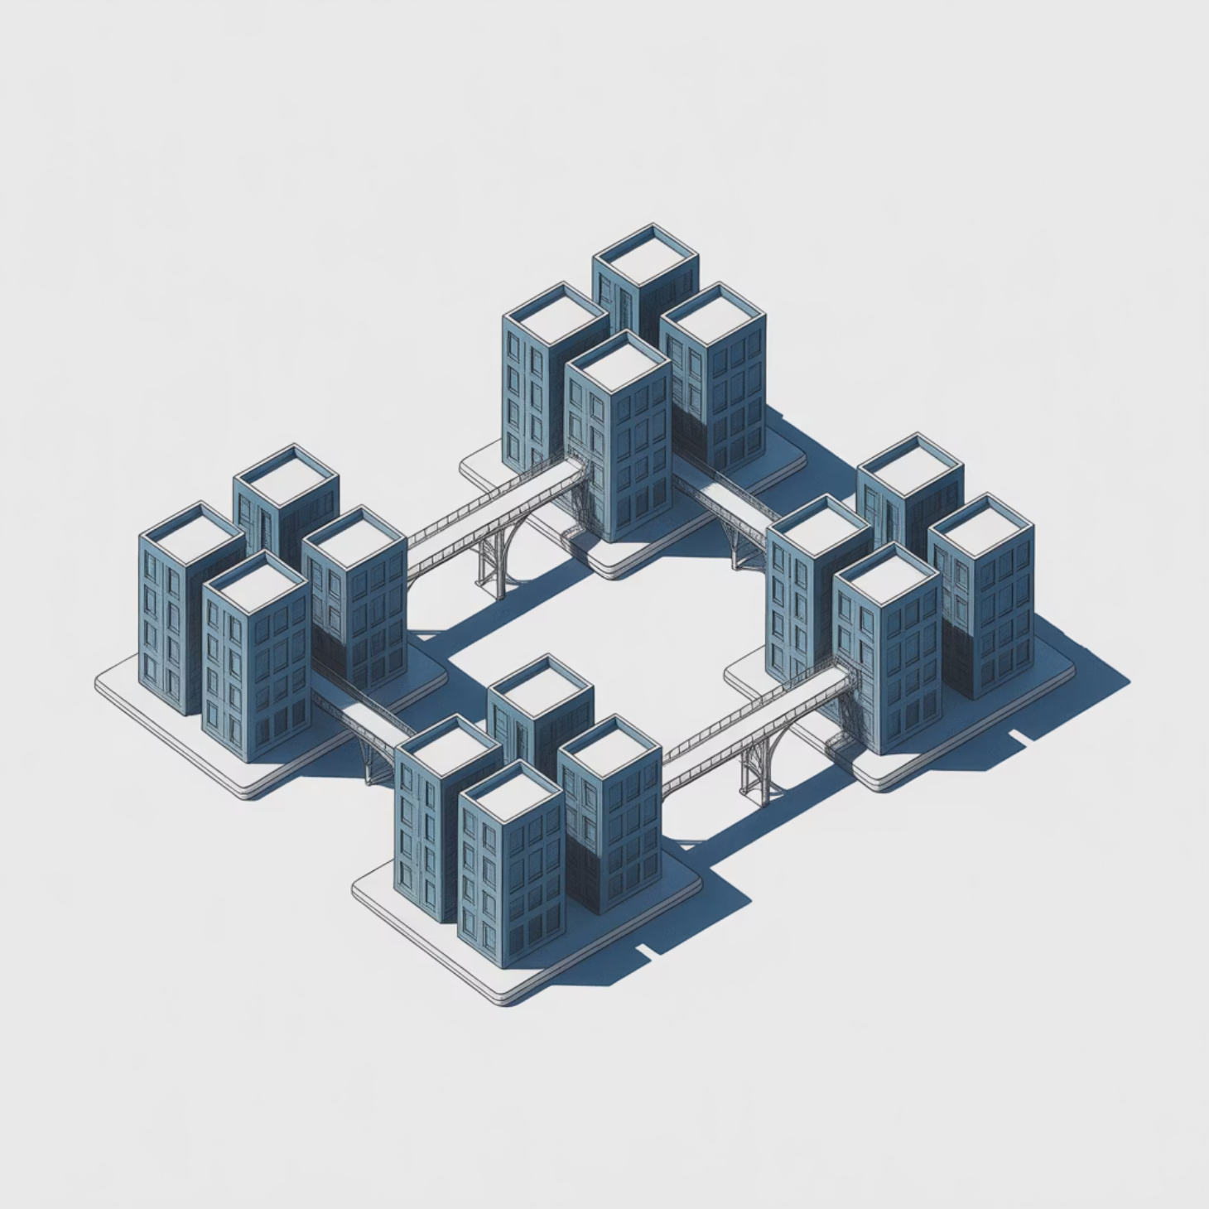
Common Domain Silos
Organizations typically manage human resources, IT operations, physical facilities, and vendor relationships as separate resilience domains, creating critical vulnerabilities.
Separate Planning: Human, IT, facilities, and vendors often develop isolated recovery strategies without cross-domain coordination.
Misaligned Objectives: Lack of synchronization leads to conflicting RTOs, RPOs, and resource allocation priorities during recovery operations.
Communication Gaps: Independent communication plans create confusion and delay coordinated response efforts.
Resource Conflicts: Competing recovery priorities result in inefficient use of limited resources and extended downtime.
Notes:
Domains operate independently Misaligned targets create friction Communication lacks synchronization Resources collide during activation Silos increase overall recovery time
Example: Facilities reopens buildings before HR confirms staff availability. Cyber example: IT restores apps before vendor connectivity is validated.

Slide 5

Integration Framework Overview
Successful domain integration requires a structured, layered approach that addresses strategic alignment, tactical coordination, and operational execution.
Strategic Layer
Tactical Layer
Executive leadership alignment, governance structures, and organizational resilience vision
Cross-domain coordination, resource planning, and integrated communication protocols
Operational Layer
Plan execution, testing coordination, and real-time incident response management
Notes:
Strategy guides unified direction Tactical coordination aligns domains Operational actions synchronize execution Layered structure reduces confusion Framework strengthens organizational maturity
Example: Leadership sets shared goals while teams align procedures underneath. Cyber example: IT, security, and vendors follow one coordinated incident flow.

Slide 6
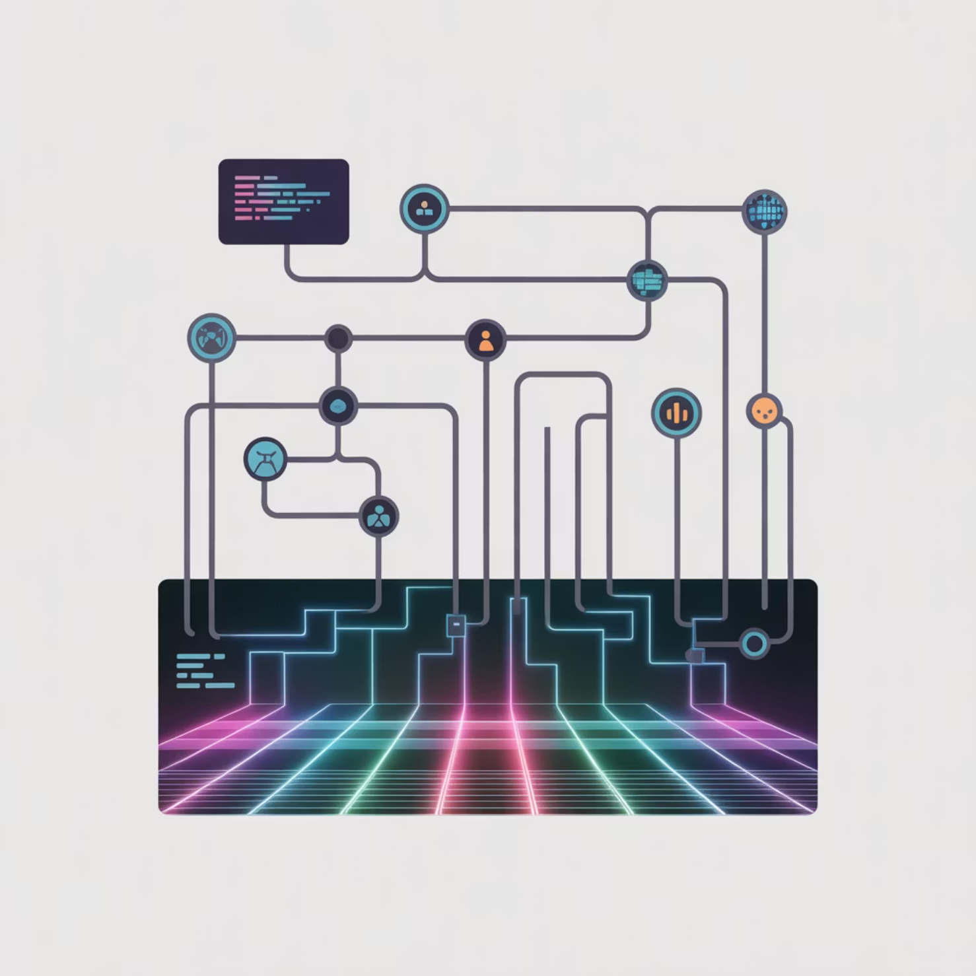
Mapping Domain Dependencies
Understanding interdependencies across systems, facilities, personnel, and vendor relationships is fundamental to creating effective integrated resilience strategies.
System Dependencies: Identify which IT systems support human resources operations, facility management, and vendor communications.
Facility Requirements: Document how physical locations support technology operations, staff functions, and vendor access needs.
Human Resource Links: Map critical personnel roles that span multiple domains and recovery functions.
Vendor Interconnections: Analyze shared assets, services, and recovery dependencies among third-party providers.
Integration Mapping: Create comprehensive visualization of resilience linkages to guide unified planning efforts.
Notes:
Systems rely on cross-functional support Facilities impact tech and personnel access Key roles span multiple domains Vendors influence recovery timing Dependency maps guide unified planning
Example: Staff cannot work when facilities power and IT systems misalign. Cyber example: Identity systems block vendor access during a recovery task.

Slide 7

Aligning Objectives Across Domains
Successful integration requires harmonizing recovery objectives and establishing shared priorities that reflect true business impact and operational dependencies.
RTO/RPO Harmonization: Align Recovery Time Objectives and Recovery Point Objectives across human, physical, cyber, and vendor domains to eliminate conflicts.
Criticality Ranking: Use business impact analysis to define shared priority levels that guide resource allocation and recovery sequencing decisions.
Dependency Integration: Ensure domain plans reflect interdependencies and support coordinated recovery actions rather than independent responses.
Performance Metrics: Establish unified success criteria and key performance indicators that measure integrated recovery effectiveness.
Notes:
RTOs and RPOs must align Criticality ranked consistently Dependencies considered in plans Metrics measure integrated success Shared targets reduce conflicts
Example: Teams agree on one priority order for restarting operations. Cyber example: Backup timing matches application recovery sequencing.

Slide 8
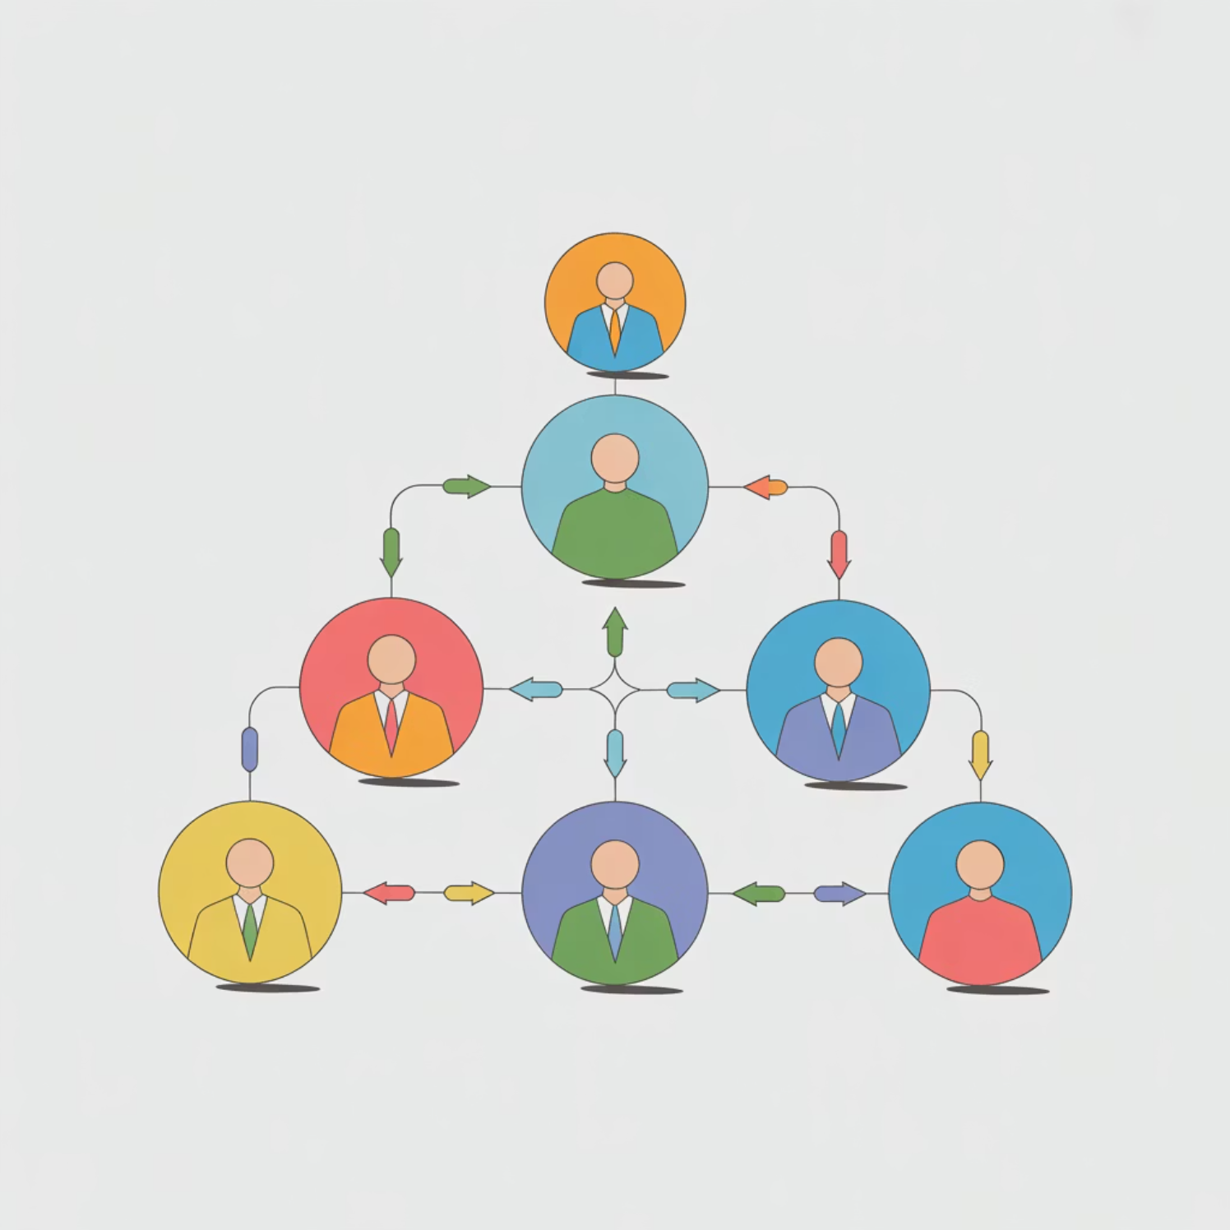
Governance and Ownership Structure
Effective integrated resilience requires clear governance structures that establish accountability, decision-making authority, and coordinated oversight across all domains.
Unified Steering Committee: Establish executive-level resilience committee with representatives from all critical business functions and domains.
Domain Leadership: Assign specific domain leads with clear accountability for their area while maintaining integration responsibilities.
Integrated Reporting: Create consolidated reporting structures that provide enterprise-wide visibility into resilience status and performance.
Decision Authority: Define escalation paths and decision-making protocols that enable rapid, coordinated response during incidents.
Compliance Alignment: Ensure governance structures support DRI certification requirements and industry best practices.
Notes:
Steering committee sets direction Domain leads maintain accountability Integrated reporting increases clarity Clear authority speeds decisions Governance aligns with standards
Example: A central committee approves updates across all departments. Cyber example: Security lead escalates coordinated actions during incidents.

Slide 9

Information Flow and Coordination
Seamless communication and coordination mechanisms are essential for executing integrated resilience strategies during both planned testing and actual incident response.
Communication Architecture: Establish clear, redundant communication paths that enable real-time coordination across all domains during incidents.
Escalation Protocols: Define specific triggers, contact sequences, and decision points that ensure appropriate stakeholder engagement at each phase.
Integrated Notifications: Combine HR, IT, facilities, and vendor communication plans into unified alert and notification systems.
Status Reporting: Create standardized situation reports that provide consistent, timely updates across all recovery operations and stakeholder groups.
Notes:
Communication paths defined clearly Escalation rules trigger involvement Notifications follow one model Reporting stays consistent across teams Coordination improves incident speed
Example: All teams receive identical updates during a building shutdown. Cyber example: Unified alerts notify IT, security, and vendors simultaneously.

Slide 10

Testing for Integration Effectiveness
Comprehensive testing programs must validate integration effectiveness through coordinated exercises that simulate real-world scenarios and cross-domain dependencies.
Joint Simulations: Conduct integrated exercises that involve all domains simultaneously, testing coordination mechanisms and communication protocols.
Scenario Complexity: Design test scenarios that specifically challenge cross-domain dependencies and require coordinated recovery actions.
Synchronization Validation: Verify that recovery actions across domains support rather than conflict with each other during execution.
Performance Measurement: Document integration effectiveness metrics and identify gaps requiring plan refinement or additional coordination.
Continuous Improvement: Use testing results to enhance integration mechanisms and strengthen cross-domain coordination capabilities.
Notes:
Joint exercises validate alignment Scenarios stress cross-domain links Synchronization issues become visible Metrics track performance gaps Testing strengthens coordinated readiness
Example: Practice drill reveals handoff delays between HR and facilities. Cyber example: Tabletop shows security and IT restore systems out of order.

Slide 11

Unified Plan Documentation
Integrated resilience strategies require comprehensive documentation management that ensures consistency, accessibility, and maintainability across all organizational domains.
Central Repository: Consolidate all domain-specific plans into accessible, searchable central documentation system with appropriate access controls.
Version Control: Implement rigorous change management processes that maintain synchronization across related plans and prevent conflicting information.
Standardized Format: Use consistent documentation templates, terminology, and organizational structures that facilitate cross-domain understanding and execution.
Integration Maps: Include clear documentation of interdependencies, coordination points, and shared resources across all domain plans.
Accessibility Design: Ensure documentation supports rapid access during incidents while maintaining appropriate security and confidentiality requirements.
Notes:
Plans stored in one location Version control prevents drift Formats stay consistent across domains Dependencies documented clearly Access designed for fast retrieval
Example: All updated plans kept in one shared repository. Cyber example: Version tracking ensures security and IT use synced procedures.

Slide 12

Integration with Risk and Compliance
Unified resilience planning must align with enterprise risk management frameworks and regulatory compliance requirements to ensure comprehensive organizational protection.
Enterprise Risk Alignment: Link integrated domain strategies with overall enterprise risk management processes and risk appetite statements.
Regulatory Compliance: Ensure unified plans meet ISO 22301 standards and align with DRI Professional Practices for certification readiness.
Audit Readiness: Structure integrated plans to support internal and external audit requirements with clear evidence of compliance and effectiveness.
Risk Assessment Integration: Incorporate cross-domain risk scenarios into regular risk assessment cycles and business impact analysis updates.
Compliance Monitoring: Establish ongoing compliance verification processes that validate integration effectiveness and regulatory alignment.
Notes:
Plans align with enterprise risk Regulations shape structure Audits require documented evidence Risk scenarios updated regularly Compliance monitoring ensures alignment
Example: Risk team updates plans after business changes. Cyber example: ISO 22301 review flags inconsistent recovery timing.

Slide 13
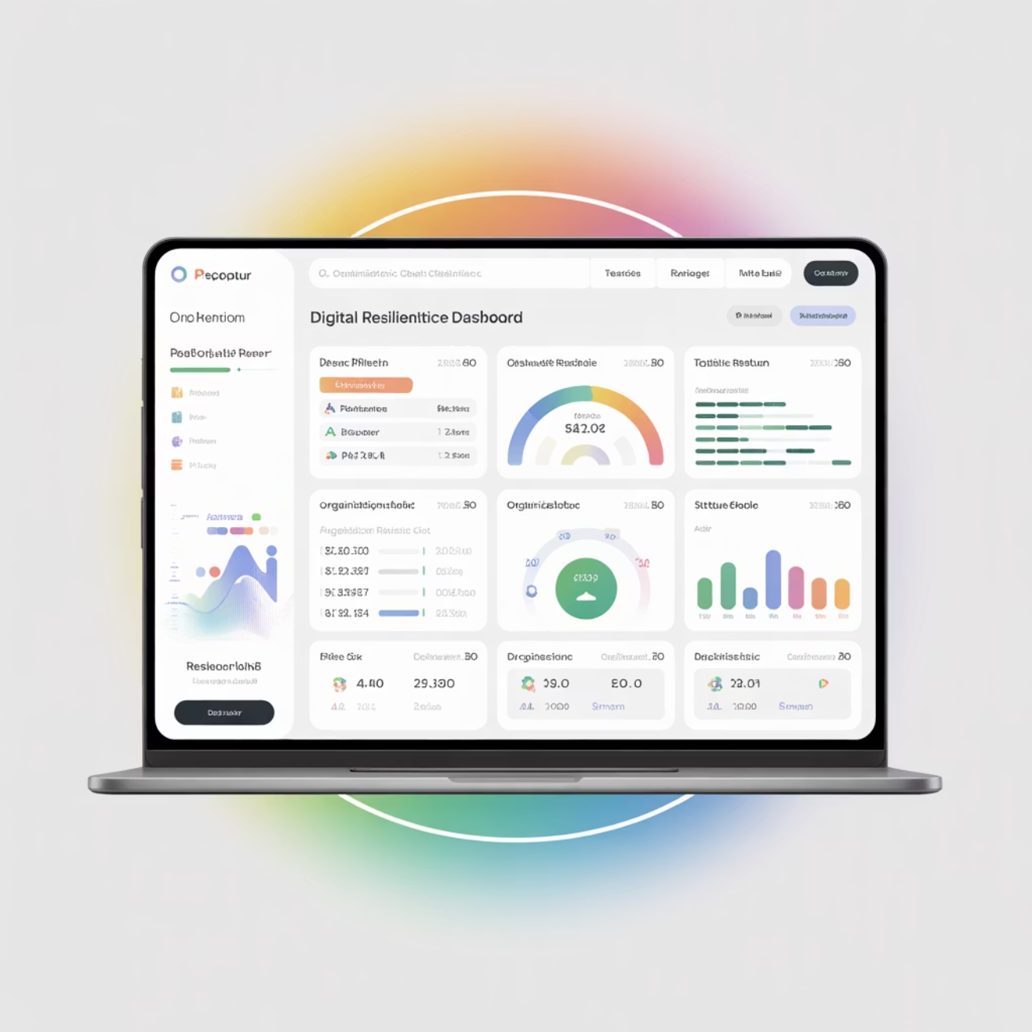
Role of Technology in Integration
Technology platforms and automation capabilities play crucial roles in enabling, coordinating, and scaling integrated resilience strategies across organizational domains.
Automation Benefits: Implement automated coordination tools that improve response timing, reduce human error, and ensure consistent execution of integrated procedures.
Centralized Platforms: Deploy integrated platforms that centralize resilience data, metrics, and coordination capabilities across all domains.
Real-time Coordination: Use technology to enable real-time status sharing, resource tracking, and decision support during incident response operations.
Scalability Support: Leverage technology solutions that support organization growth and increasing complexity of integrated resilience requirements.
Data Integration: Establish data sharing and analysis capabilities that provide comprehensive visibility into cross-domain resilience performance.
Notes:
Automation accelerates coordination Platforms centralize resilience data Real-time updates support decisions Tools scale with growing needs Integrated data improves visibility
Example: Shared dashboard displays building and team status. Cyber example: Incident platform tracks system restoration across domains.

Slide 14
Overcoming Integration Challenges
Organizations commonly encounter predictable obstacles when implementing integrated resilience strategies, requiring proactive mitigation approaches and stakeholder management.
Common Integration Challenges:
Conflicting Priorities: Different domains may have competing resource needs and conflicting recovery objectives requiring executive resolution.
Limited Leadership Buy-in: Insufficient executive sponsorship can undermine integration efforts and perpetuate siloed approaches.
Tool Fragmentation: Multiple, incompatible tools and processes across domains create coordination difficulties and information gaps.
Cultural Resistance: Existing departmental cultures may resist cross-domain collaboration and shared accountability structures.
Mitigation Strategies:
Executive Alignment: Secure visible leadership commitment and establish shared key performance indicators across domain leads.
Gradual Implementation: Phase integration initiatives to build success momentum and demonstrate value before expanding scope.
Notes:
Priorities often conflict across teams Leadership support sometimes lacking Tools vary between departments Culture resists shared ownership Mitigation requires phased rollout
Example: HR and facilities argue over reopening priorities. Cyber example: Security refuses to adopt shared tooling with IT.

Slide 15
Continuous Improvement Cycle
Integrated resilience requires ongoing refinement and maturation through systematic improvement processes that strengthen coordination capabilities over time.
Ongoing Process: Integration is not a one-time implementation but requires continuous attention and refinement as organizations evolve and threats change.
Lessons Learned Integration: Systematically capture insights from incidents, tests, and operational experiences to enhance integration mechanisms.
Maturity Assessment: Regularly evaluate integration effectiveness using maturity models and benchmark against industry best practices.
Iterative Enhancement: Build organizational maturity through planned, iterative improvements that strengthen cross-domain coordination capabilities.
Performance Evolution: Maintain ongoing commitment to continuing education and industry activities supporting certification requirements.
Notes:
Integration reviewed continuously Lessons incorporated after events Maturity assessed against models Enhancements planned regularly Education supports ongoing progress
Example: Company updates plans after every storm season. Cyber example: Post-incident review improves response workflow.

Slide 16
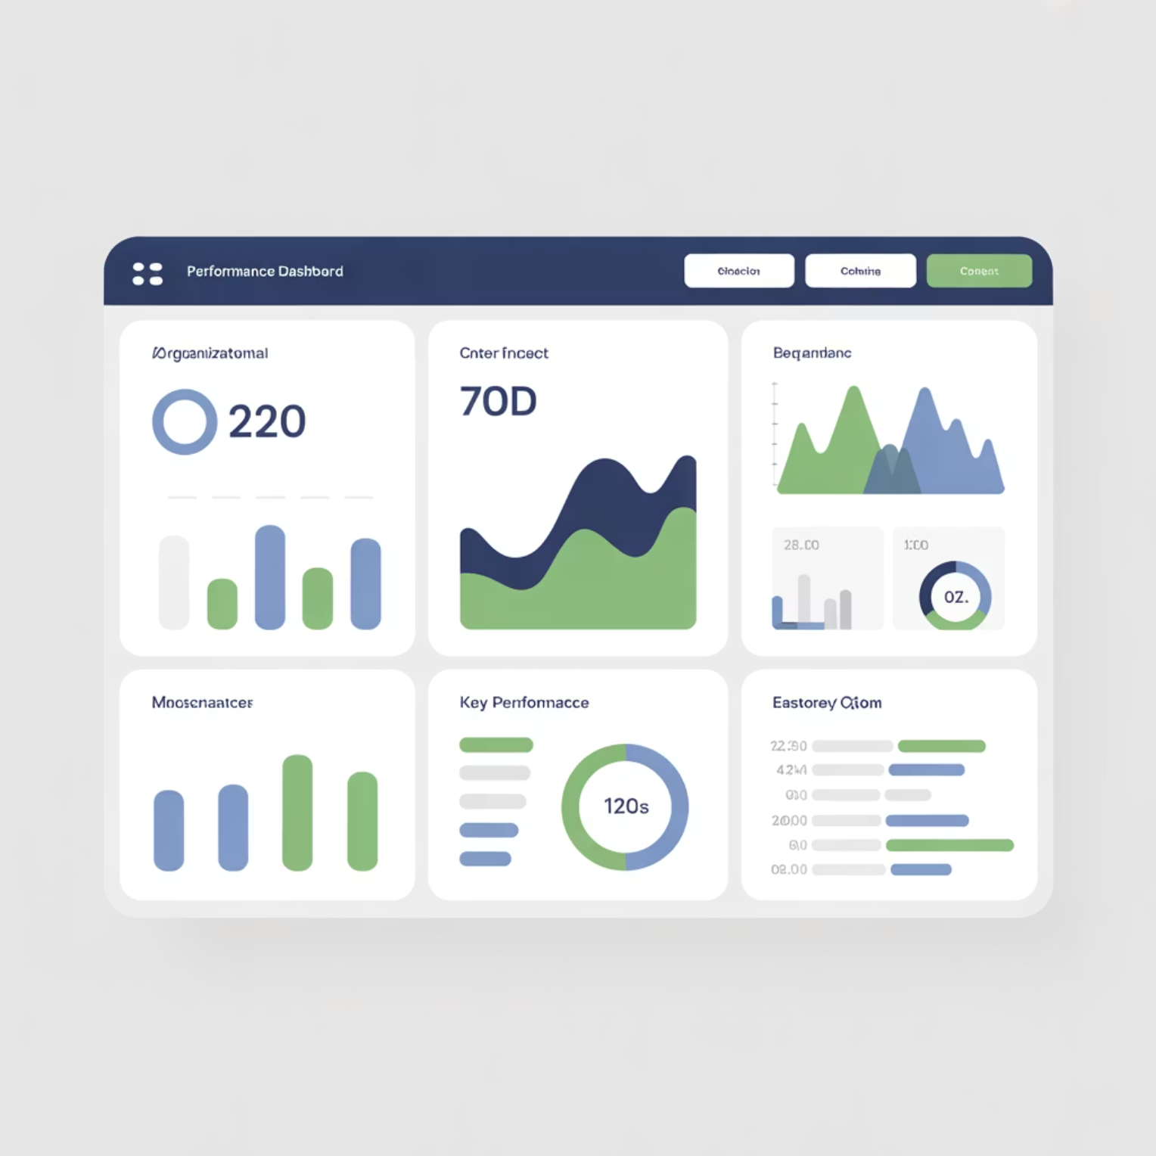
Integration Metrics and KPIs
Effective measurement of integration success requires specific key performance indicators that demonstrate coordination effectiveness and identify improvement opportunities.
Essential Integration Metrics:
Cross-Domain Test Success Rate: Percentage of joint exercises that meet coordinated recovery objectives without significant coordination failures.
RTO/RPO Alignment Percentage: Degree of consistency between domain-specific recovery objectives and actual coordinated recovery performance.
Governance Participation Rate: Active engagement levels in integrated governance structures and cross-domain coordination activities.
Communication Effectiveness: Speed and accuracy of information flow during incidents and exercises across all domain boundaries.
Resource Utilization Efficiency: Optimization of shared resources and elimination of conflicting resource allocation during recovery operations.
Performance Measurement:
Regular assessment cycles aligned with organizational planning and budget cycles
Trend analysis to identify integration maturity progression over time
Notes:
Testing success measures alignment Aligned objectives validate consistency Governance participation shows engagement Communication speed tracked closely Resource use monitored for efficiency
Example: Organization sees faster recovery across multiple exercises. Cyber example: Reduced system overlap during coordinated restoration.

Slide 17
Case Study: Unified Resilience in Practice
A mid-sized manufacturing enterprise successfully integrated IT, human resources, facilities, and vendor management into a unified resilience framework with measurable results.
Integration Implementation:
Baseline Challenge: Separate domain plans resulted in 8-hour average recovery times due to coordination delays and resource conflicts.
Integration Approach: Established cross-functional resilience committee with representatives from IT, HR, facilities, and vendor management.
Unified Testing: Implemented quarterly joint exercises involving all domains with coordinated scenario development and evaluation.
Measurable Results:
RTO Improvement: Improved RTO alignment by 40% after implementing unified testing and coordination protocols.
Communication Enhancement: Reduced incident notification time from 45 minutes to 12 minutes through integrated communication systems.
Key Success Factors:
Strong executive sponsorship and centralized coordination authority
Regular cross-domain communication and shared performance metrics
Notes:
Independent plans caused long delays Committee improved coordination Joint testing reduced confusion Metrics showed faster recovery Success depended on strong leadership
Example: Recovery time dropped significantly after teams merged plans. Cyber example: Notification delays shortened after adopting unified alerts.

Slide 18

Key Integration Tools
Successful domain integration relies on appropriate technology tools and platforms that enable coordination, communication, and performance monitoring across organizational boundaries.
Essential Integration Tools:
Governance Dashboards: Executive-level visibility platforms that provide real-time status across all domains and integration performance metrics.
Plan Management Systems: Centralized platforms for maintaining, updating, and coordinating domain-specific plans with version control and change tracking.
Workflow and Incident Platforms: Integrated systems that coordinate response actions, resource allocation, and communication across domain boundaries during incidents.
Communication Tools: Unified notification and collaboration platforms that support cross-domain coordination and stakeholder engagement.
Testing and Exercise Platforms: Tools that enable coordinated exercise planning, execution, and evaluation across multiple domains simultaneously.
Tool Selection Criteria:
Integration capabilities with existing domain-specific systems
Scalability to support organizational growth and increasing complexity
Security and compliance features appropriate for organizational requirements
Notes:
Dashboards show cross-domain status Plan systems centralize documentation Workflows coordinate recovery tasks Communication tools unify alerts Testing platforms structure exercises
Example: A dashboard highlights facility and HR readiness in real time. Cyber example: Automated playbooks guide security and IT responses.

Slide 19
Steps to Build a Unified Recovery Plan
Creating effective integrated resilience requires systematic approach with clear phases, stakeholder engagement, and measurable outcomes at each stage of development.
1
2
Consolidate Domain Inputs
Define Shared Objectives
Gather existing domain plans, assess current capabilities, and identify integration opportunities and gaps across all organizational resilience functions.
Establish unified recovery objectives, harmonize RTOs and RPOs, and create consistent prioritization criteria across all domains.
3
4
Integrate Governance and Testing
Document and Maintain Alignment
Implement cross-domain governance structures and develop coordinated testing programs that validate integration effectiveness.
Create comprehensive documentation, establish change management processes, and implement continuous improvement mechanisms for long-term success.
Notes:
Collect all domain inputs first Define one shared objective set Align governance and testing Document changes and maintain alignment Repeat improvements as structure evolves
Example: Teams combine separate binders into one unified plan set. Cyber example: IT and security agree on shared RTOs before testing.

Slide 20

Summary and Key Takeaways
Integration Imperative: Unified domain strategies enable coordinated recovery operations and sustainable organizational continuity through elimination of silos and conflicts.
Systematic Approach: Successful integration requires structured frameworks addressing strategic, tactical, and operational layers with clear governance and accountability.
Continuous Evolution: Integrated resilience is an ongoing maturity journey requiring continuous alignment, testing, and improvement to maintain effectiveness over time.
Measurable Value: Organizations implementing unified resilience strategies demonstrate improved efficiency, faster recovery times, and enhanced stakeholder confidence.
Certification Alignment: Integrated approaches support DRI certification requirements and demonstrate professional competency in comprehensive resilience management.
Remember: Integration drives organizational resilience maturity and long-term sustainability success.
Notes:
Integration eliminates silos Structure drives consistent action Maturity grows through alignment Testing proves effectiveness Unified plans protect continuity
Example: Company recovers faster after implementing coordinated processes. Cyber example: Incident response shortens when teams use one integrated plan.

Slide 21
BREAK TIME
Be back in 15 mins.
Notes:
https://www.ncsc.gov.uk/static-assets/documents/PwnedPasswordsTop100k.txt

Slide 22

Workshop: Critique, Merge & Improve Plans
Domain-Specific Resilience Strategies Module
This advanced workshop teaches resilience professionals how to evaluate fragmented domain-level plans, identify critical gaps and misalignments, and integrate them into a unified organizational resilience structure. Essential preparation for DRI International certifications including ABCP, CBCP, ACRP, and CCRP.
Why This Workshop Matters
Fragmented plans weaken overall resilience posture
Critique precedes successful integration
Cross-domain consistency drives recovery success
Unified resilience delivers stronger business outcomes

Slide 23
CLASS AGENDA
CLASS OBJECTIVES
Assessment and Critique: Systematic evaluation of existing domain plans
Identifying Misalignments: Spotting gaps, conflicts, and redundancies across domains
Merging Plan Components: Strategic integration methodologies and best practices
Governance Improvement: Strengthening oversight and accountability structures
Structural Assessment: Identify and evaluate structural gaps in domain-specific resilience plans
Logical Integration: Merge fragmented strategies into unified, coherent resilience structures
Governance Enhancement: Strengthen governance frameworks and improve organizational clarity
Certification Readiness: Build competencies essential for DRI International professional advancement

Slide 24

Why Domain Plans Require Review
When business units develop resilience plans independently, critical misalignments emerge that compromise organizational recovery effectiveness.
Independent Development Issues: Siloed planning creates conflicting priorities and inconsistent approaches across business domains
RTO/RPO Gap Impact: Misaligned recovery objectives reduce overall recovery success rates and extend downtime
Limited Cross-Domain Visibility: Teams lack awareness of dependencies and resource conflicts with other domains
Systematic critique builds the foundation for successful integration and improved resilience maturity.
Notes:
Independent plans create misalignment RTO gaps extend downtime Teams lack cross-domain visibility Systematic critique exposes issues Review strengthens resilience posture
Example: Conflicting priorities cause slow reopening during disruption. Cyber example: App team recovers systems no one depends on first.

Slide 25
Key Elements to Assess in Each Plan
A comprehensive critique framework ensures thorough evaluation of every domain plan component before integration begins.
Scope & Dependencies
Governance Structure
Complete process coverage analysis
Clear role definitions and accountability
Cross-domain dependency mapping
Escalation path documentation
Resource requirement documentation
Decision-making authority mapping
Recovery Sequencing
Testing & Version Control
Priority tier alignment verification
Exercise history and results
RTO/RPO consistency checking
Plan update frequency tracking
Interdependency validation
Change management processes
Notes:
Scope must cover full process Dependencies documented clearly Governance roles defined well Recovery sequencing checked Testing history reviewed thoroughly
Example: HR plan missing facilities dependency causes delays. Cyber example: App relies on network that is not prioritized early enough.

Slide 26

Identifying Gaps and Weaknesses
Systematic gap analysis reveals critical weaknesses that undermine plan effectiveness and organizational resilience capabilities.
Ownership Ambiguity- Missing or unclear accountability structures create confusion during crisis response and delay decision-making
Terminology Inconsistencies- Conflicting definitions and structural approaches hinder communication and coordination across domains
Operational Realism Deficits- Plans lacking practical testing evidence or operational validation fail during actual incidents
Enterprise Risk Disconnection- Weak linkage to overall risk management reduces strategic alignment and resource optimization
Notes:
Ownership unclear across teams Terminology differs between plans Operational steps lack realism Risk alignment often missing Gaps reduce execution success
Example: No one knows who approves recovery steps. Cyber example: Unverified playbooks fail during real attack.

Slide 27
Spotting Redundancies or Conflicts
Identifying overlapping actions and conflicting requirements prevents resource waste and operational friction during recovery operations.
Duplicate Actions
Conflicting RTO Targets
Multiple domains performing identical tasks wastes resources and creates coordination challenges
Incompatible recovery time objectives create impossible dependencies and unrealistic expectations
Resource Contention
Pre-Merge Alignment
Competing demands for the same personnel, systems, or facilities during crisis response
Resolution of conflicts must occur before attempting integration to ensure plan coherence
Notes:
Duplicate tasks waste resources Conflicting targets create friction Resource demands collide Dependencies unclear across plans Fix issues before merging
Example: Two teams attempt same communication tasks. Cyber example: Two groups request same server capacity.

Slide 28
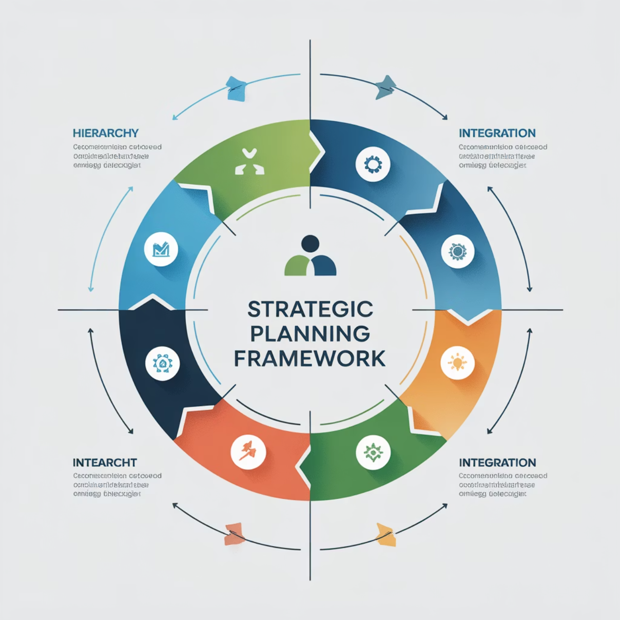




Criteria for Merging Plans
Successful plan integration requires clear criteria and systematic methodology to ensure logical coherence and operational effectiveness.
Criticality-First Prioritization
Business-critical processes take precedence in resource allocation and recovery sequencing
Cross-Team Recovery Alignment
Harmonized recovery objectives and coordinated restoration timelines across all domains
Unified Governance Structure
Consolidated oversight model with clear accountability and streamlined decision-making
Standardized Documentation
Consistent formats, terminology, and maintenance procedures across all plan components
Notes:
Prioritize by criticality Align timelines across domains Use unified governance model Standardize documentation formats Ensure consistency before merging
Example: Teams reorganize priorities based on business impact. Cyber example: Shared sequence ensures backup restores support applications.

Slide 29
Preparing Plans for Integration
Pre-integration preparation ensures smooth consolidation and prevents conflicts during the merging process.
Normalize Language & Definitions
Establish common terminology and consistent definitions across all domain plans
Align Escalation Rules
Harmonize reporting structures and decision-making authority across all domains
Confirm Dependencies
Validate and document all cross-domain interdependencies and resource requirements
Centralize Ownership Mapping
Create comprehensive accountability framework with clear role assignments
Notes:
Standardize terminology first Align escalation pathways Confirm dependencies thoroughly Map ownership across domains Preparation prevents integration issues
Example: Teams align language before updating procedures. Cyber example: Security and IT agree on escalation triggers.

Slide 30
Building a Unified Resilience Structure
The integrated structure consolidates domain-specific controls into a coherent, enterprise-wide resilience framework.
Shared Accountability Model
Consolidated Control Hierarchy
Cross-functional ownership ensuring both domain expertise and enterprise-wide coordination
Merge individual domain controls into single, comprehensive organizational resilience structure
Integrated Playbook
Unified Escalation Path
Comprehensive operational guide combining all domain strategies into cohesive response procedures
One clear crisis escalation route eliminating confusion and accelerating response times
Notes:
Controls merged into one hierarchy Ownership shared cross-functionally One escalation path defined Playbook consolidates procedures Structure reduces confusion
Example: One chain of command replaces three separate versions. Cyber example: One playbook defines steps for cyber and IT recovery.

Slide 31
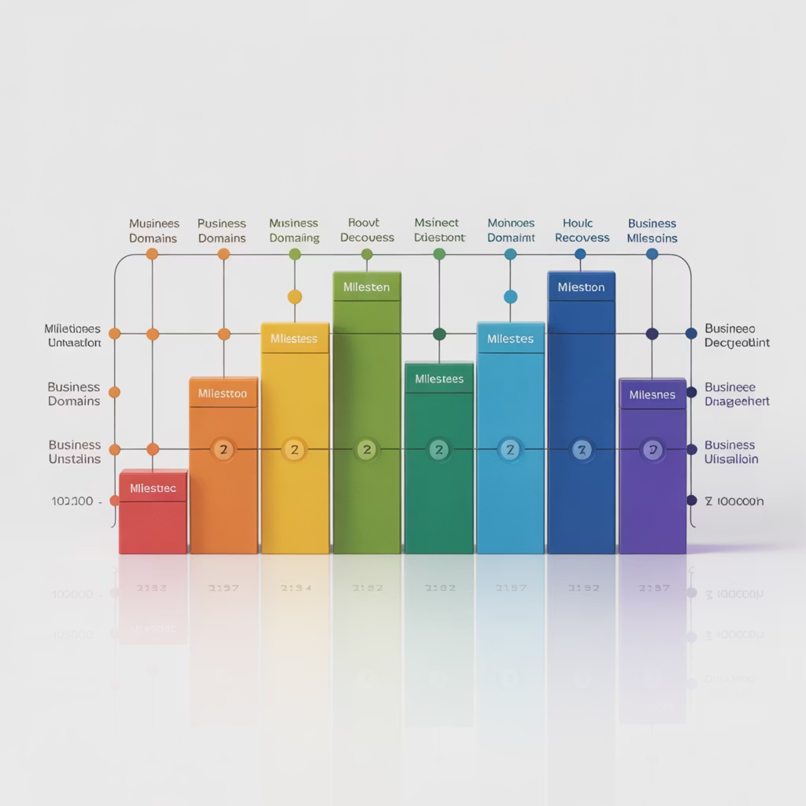
Recovery Alignment
Synchronized recovery processes ensure coordinated restoration, minimizing conflicts during crises.
Cross-Domain Tiers: Integrated priority structure across all business domains.
Consistent RTO/RPO: Harmonized recovery objectives, eliminating conflicts.
Phased Restoration: Sequential approach optimizing resource allocation.
Documented Dependencies: Mapping shared resources and cross-domain needs.
Notes:
Cross-domain priorities synchronized RTOs kept consistent across plans Phased restoration improves flow Dependencies documented clearly Alignment removes execution friction
Example: Teams restore critical services in agreed order. Cyber example: Storage restored before applications relying on it.

Slide 32

Integration Principles
Successful resilience plan integration requires adherence to fundamental principles that ensure operational effectiveness and long-term sustainability.
Interoperability
Friction Reduction
Plans must work seamlessly together without conflicts or operational gaps during execution
Integration eliminates organizational delays and streamlines crisis response coordination
Enhanced Readiness
Governance Foundation
Aligned plans improve organizational preparedness and response effectiveness
Strong governance structures serve as the anchor for resilience maturity advancement
Critical Success Factor: Integration without proper governance creates new risks. Establish oversight structures before consolidating operational plans.
Notes:
Plans must interoperate smoothly Reduced friction improves speed Readiness increases through alignment Governance remains core requirement Principles guide resilient structures
Example: Departments coordinate instead of waiting for each other. Cyber example: Response steps integrate IT and security actions cleanly.

Slide 33
Strengthening Governance
Robust governance frameworks provide the foundation for effective plan integration and long-term resilience program success.
Unified Steering Committee
Clear Ownership & Escalation
Centralized oversight body with cross-functional representation and strategic decision-making authority
Defined plan ownership responsibilities with transparent escalation rights and authority levels
Standardized BCM Reporting
Leadership Approval Cycles
Consistent reporting mechanisms feeding directly into the business continuity management program
Structured review and approval processes ensuring executive alignment and resource commitment
Notes:
Steering committee centralizes oversight Ownership clearly documented Reporting standardized across domains Leadership approves major updates Governance stabilizes execution
Example: All plan updates flow to one governing body. Cyber example: Security escalates issues through unified authority path.

Slide 34

Communication Flow Improvements
Streamlined communication protocols eliminate information fragmentation and accelerate crisis response coordination across all organizational domains.
Eliminate Messaging Fragmentation: Consolidated communication channels preventing conflicting information and reducing confusion
Shared Crisis Protocol: Unified communication framework ensuring consistent messaging and coordinated public response
Standard Chain-of-Command: Clear hierarchical communication structure eliminating ambiguity during crisis escalation
Domain Handoff Clarity: Defined transfer procedures and communication requirements between domain teams
Notes:
Messaging centralized for clarity Shared crisis protocol enforced Chain-of-command standardized Handoffs clearly documented Unified flow improves speed
Example: Staff updates come from one source during emergencies. Cyber example: Alerts synchronized across IT, security, and vendors.

Slide 35





Testing Integrated Plans
Comprehensive testing validates plan integration effectiveness and identifies remaining friction points that require resolution.
Joint Simulations
Friction Point Identification
Cross-functional exercises validate alignment and test coordination mechanisms
Systematic identification of remaining operational conflicts and coordination challenges
Certification Readiness
Structured Improvement
Testing builds competencies essential for DRI International professional advancement
Formal feedback cycles driving continuous refinement and plan optimization
Notes:
Joint simulations test alignment Friction points identified early Improvements structured after review Testing supports certification readiness Exercises validate integration strength
Example: Cross-team drill finds slow communication handoff. Cyber example: Recovery test shows restore order misaligned.

Slide 36

Documentation Improvements
Consolidated documentation standards ensure consistency, traceability, and operational clarity across the integrated resilience framework.
Master Documentation Set: Single consolidated repository eliminating document fragmentation and version conflicts
Version Control & Change Tracking: Comprehensive change management ensuring traceability and preventing unauthorized modifications
Built-in Audit Alignment: Documentation structure supporting audit requirements and compliance validation
Stress-Tested Clarity: Clear, actionable documentation that maintains effectiveness under high-stress crisis conditions
Notes:
Master set removes fragmentation Strong version control applied Audit needs built into structure Clarity maintained under stress Documentation stays consistent
Example: One repository replaces scattered documents. Cyber example: Teams follow same version-controlled cyber playbook.

Slide 37
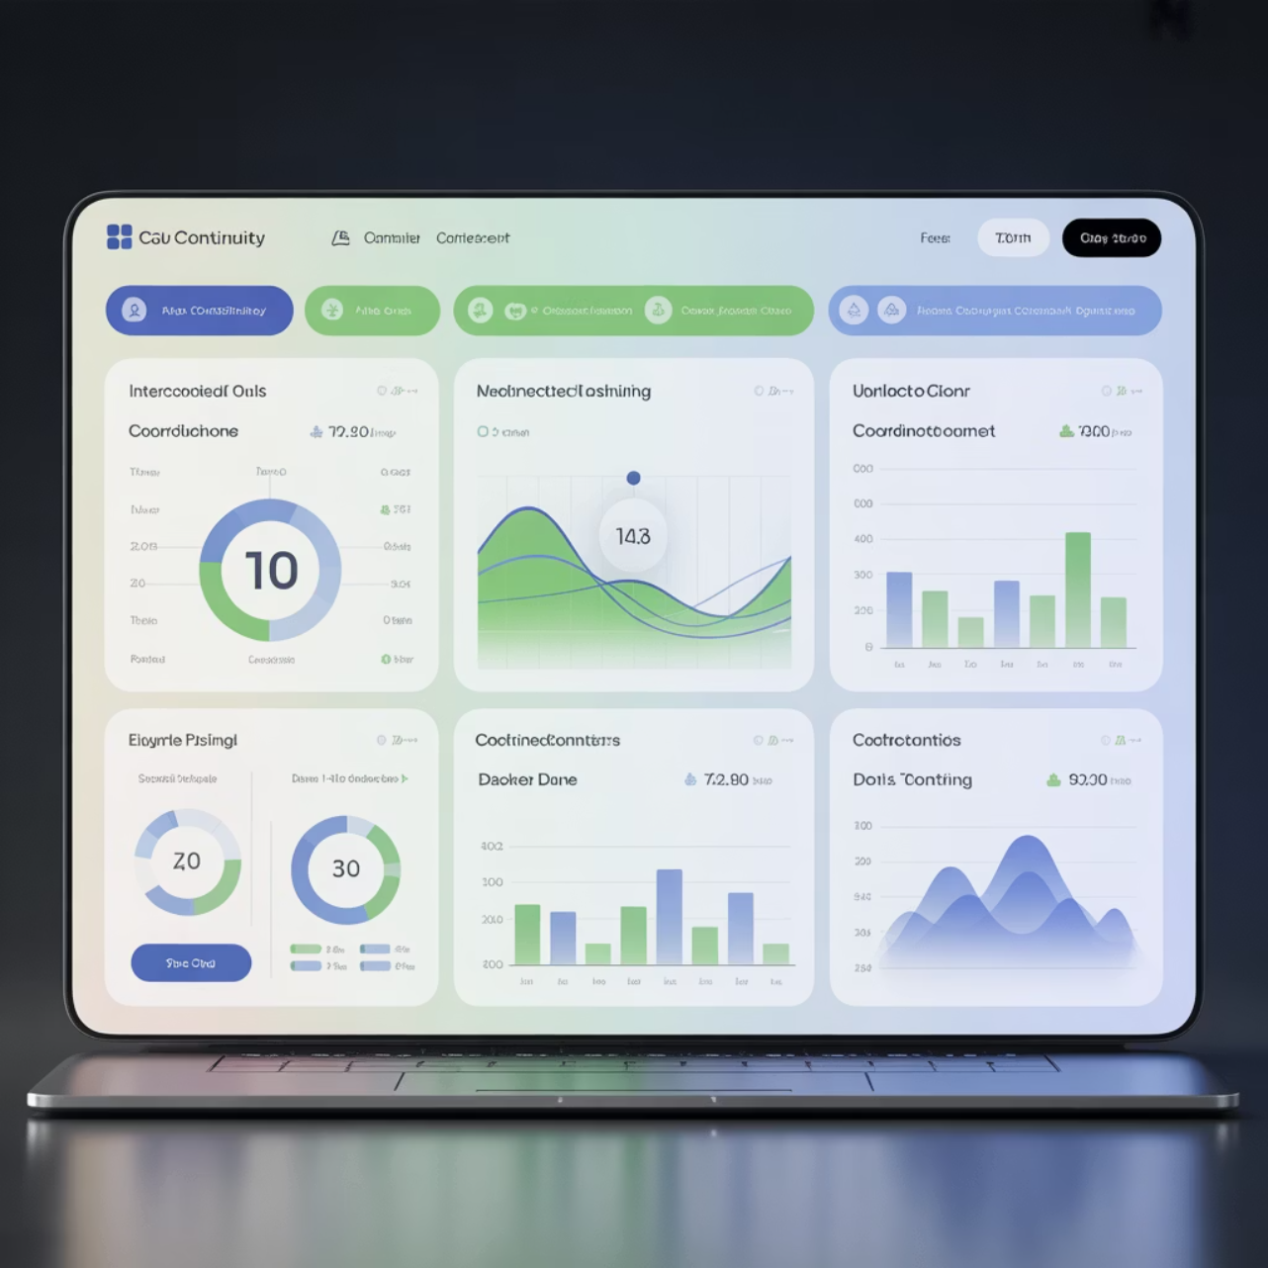
Tools Supporting Integration
Specialized technology platforms facilitate plan integration, coordination, and ongoing management of unified resilience structures.
Governance Dashboards: Real-time oversight visibility and performance monitoring across integrated domains
Documentation Platform: Centralized repository supporting collaboration and version control
Role-Mapping Tools: Clear accountability visualization and responsibility tracking systems
Recovery Coordination: Automated workflow management and cross-domain communication support
Notes:
Dashboards show real-time oversight Documentation tools support updates Role maps clarify accountability Recovery tools automate workflows Technology enables coordination
Example: Dashboard displays recovery status for leadership. Cyber example: Automated platform assigns tasks during incidents.

Slide 38

Measuring Integration Success
Quantifiable metrics demonstrate integration effectiveness and provide objective evidence of improved resilience capabilities.
Target Alignment: Percentage of aligned recovery objectives across all integrated domains
Duplication Reduction: Measured decrease in redundant activities and resource conflicts
Pass Rate Improvement: Enhanced exercise success rates demonstrating better coordination
Capability Advancement: Quantified resilience maturity progression and certification readiness
Notes:
Targets aligned across domains Redundancies reduced significantly Exercise pass rate improves Maturity level increases visibly Metrics guide future updates
Example: Teams reduce duplicated tasks after review. Cyber example: Systems restored faster thanks to aligned targets.

Slide 39

Organizational Benefits
Successful plan integration delivers measurable improvements in organizational resilience and operational effectiveness.
Stronger Continuity Assurance
Accelerated Decision-Making
Enhanced confidence in organizational ability to maintain critical operations
Streamlined coordination enabling faster, more effective crisis response
Scalable Resilience
Transparent Accountability
Framework supporting organizational growth and evolving business requirements
Unambiguous responsibility structures improving execution and performance
Notes:
Continuity assurance improves Decisions happen faster Accountability becomes clearer Resilience scales with growth Integrated plan boosts confidence
Example: Leaders trust recovery timelines more after alignment. Cyber example: Outage duration shortens due to coordinated workflows.

Slide 40
Common Pitfalls to Avoid
Recognition and avoidance of typical integration failures prevents costly mistakes and ensures successful plan consolidation.
Integrating Without Critique
Ignoring Domain Dependencies
Skipping comprehensive assessment leads to amplified weaknesses and structural problems in the unified plan
Overlooking critical interdependencies creates operational bottlenecks and recovery delays
Over Centralized Ownership
Missing Governance Visibility
Removing too much domain expertise reduces operational effectiveness and response agility
Inadequate oversight structures prevent effective monitoring and continuous improvement
Notes:
Skipping critique weakens outcome Ignoring dependencies causes delays Over-centralization harms expertise Poor visibility disrupts oversight Avoid mistakes early in process
Example: Teams merge plans without checking conflicts. Cyber example: Dependencies ignored until systems fail in sequence.

Slide 41


Summary & Key Takeaways
Critique → Merge → Improve: Systematic assessment precedes successful integration, enabling continuous improvement
Unified Plans = Stronger Recovery: Integrated structures deliver superior resilience outcomes and operational effectiveness
Governance Anchors Integration: Strong oversight structures provide the foundation for sustainable resilience programs
Continuous Alignment Required: Resilience maturity demands ongoing alignment and refinement of integrated structures
Next Steps: Apply these integration principles to your domain plans and begin building stronger organizational resilience capabilities.
Notes:
https://www.ncsc.gov.uk/static-assets/documents/PwnedPasswordsTop100k.txt

Slide 42
BREAK TIME
Be back in 15 mins.
Notes:
https://www.ncsc.gov.uk/static-assets/documents/PwnedPasswordsTop100k.txt

Slide 43

Developing a Complementary Recovery Plan
Domain-Specific Resilience Strategies Module
This lesson prepares learners for DRI International certifications (ABCP, CBCP, ACRP, CCRP) by establishing the governance foundation for coordinated recovery execution.
Connects domain strategies into an execution-ready structure that supports enterprise oversight
Ensures recovery actions are governed and traceable through established accountability frameworks
Links operational response to enterprise resilience goals under unified command structure
Notes:
Links domain plans into execution Supports command structure clarity Tracks accountability across teams Aligns operations to strategy Enables coordinated activation
Example: Teams follow one activation flow instead of separate ones. Cyber example: Cyber and IT recovery align under shared command.

Slide 44
CLASS AGENDA
CLASS OBJECTIVES
Purpose and governance role of complementary recovery planning
Structural components and architectural design principles
Cross-domain alignment and coordination mechanisms
Oversight frameworks and validation processes
Design recovery plans aligned with BCM governance hierarchy and enterprise accountability
Improve plan traceability and integration across functional domains
Reinforce organizational resilience maturity through structured execution readiness

Slide 45

Why Complementary Plans Are Necessary
Domain plans alone do not create coordinated execution capability across enterprise functions
Complementary design ensures timing and sequencing alignment prevents resource conflicts during activation
Prevents governance gaps during real recovery situations where authority and accountability must be clear
Strengthens business continuity under enterprise oversight by providing unified command structure.
Notes:
Domain plans lack coordination Timing mismatch creates conflicts Governance gaps cause confusion Unified command clarifies authority Complementary plans strengthen continuity
Example: Facilities opens too early without HR readiness checks. Cyber example: IT restores servers before security approves access.

Slide 46

Governance Alignment Principles
Plan architecture must reflect established BCM governance hierarchy with clear reporting lines
Ownership assignment must map to accountable roles with defined authority and decision-making scope
Escalation pathways must follow a unified path that supports senior leadership oversight requirements
Structure must support senior oversight through transparent reporting and accountability mechanisms.
Notes:
Plans reflect governance structure Ownership tied to authority Escalation follows one path Oversight visibility strengthened Alignment improves decision quality
Example: All updates follow a central review process. Cyber example: Security escalations follow a standardized chain.

Slide 47

Core Components of a Complementary Recovery Plan
Trigger conditions and activation criteria that align with enterprise-level incident classification systems
Governance-driven roles and responsibilities with clear authority matrices and decision-making protocols
Recovery tiers linked to business priorities that reflect strategic criticality assessments and resource allocation
Communication model supporting oversight through structured reporting and stakeholder engagement frameworks.
Notes:
Triggers defined clearly Roles tied to authority levels Recovery tiers match priorities Communication kept structured Components guide execution
Example: Activation criteria reduce confusion during disruptions. Cyber example: Recovery tiers dictate which systems restore first.

Slide 48

Alignment with Strategy and Criticality
Recovery approach must reinforce strategic continuity objectives and enterprise value protection priorities
Critical functions restored in priority tiers that reflect business impact analysis and strategic importance
Dependencies define restoration order to minimize operational conflicts and resource competition between domains
Minimizes conflict between domains through structured coordination and resource allocation governance.
Notes:
Recovery supports enterprise goals Criticality ranks guide order Dependencies shape sequencing Competition for resources reduced Alignment avoids operational conflict
Example: Core services restored before non-critical ones. Cyber example: Database restored before dependent applications.

Slide 49

Cross-Domain Coordination
Ensures synchronized action across teams through standardized communication protocols and timing mechanisms
Builds interdependency awareness that prevents cascading failures and resource conflicts during recovery
Strengthens resource allocation control through centralized coordination and priority-based distribution frameworks
Creates unified situational picture for leadership through integrated reporting and status visibility.
Notes:
Standardized communication improves sync Interdependency awareness prevents surprises Central coordination controls resources Reporting integrated for clarity Coordination reduces recovery friction
Example: Teams coordinate staffing and facility access together. Cyber example: IT and security align patching and restoration timing.

Slide 50

RTO/RPO Governance Integration
Recovery objectives become anchors for execution timing that align with enterprise performance expectations
Alignment demonstrates maturity in planning through measurable targets and accountability mechanisms
Reduces inconsistency between domains by establishing unified performance standards and measurement criteria
Enables auditability and review through documented objectives and measurable performance indicators.
Notes:
RTOs anchor timing expectations RPOs unify data strategies Targets show planning maturity Standards reduce inconsistency Indicators support audits
Example: Teams share identical time targets for essential work. Cyber example: Backup retention matches system recovery needs.

Slide 51

Documentation Standards
Versioned and owned under governance through established change management and approval processes
Format supports rapid reference under pressure with clear procedures and easy navigation structure
Traceability ensures accountability through audit trails and ownership documentation that supports oversight
Must align with enterprise policies and regulatory requirements for documentation governance and retention.
Notes:
Versioned under change control Format optimized for stress usage Traceable for accountability Aligned with regulatory requirements Standards keep plans usable
Example: Clear sections make emergency navigation easier. Cyber example: Documentation supports audit reviews cleanly.

Slide 52

Testing and Validation
Joint exercises validate structure through realistic scenarios that test coordination and communication protocols
Failure points reveal governance gaps that require structural improvements and process refinements
Drives continuous maturity improvement through lessons learned integration and performance measurement
Confirms execution readiness through demonstrated capability and validated performance under controlled conditions.
Notes:
Exercises test governance flow Gap discovery drives updates Lessons feed maturity growth Performance validated regularly Testing confirms readiness
Example: Drill highlights unclear escalation paths. Cyber example: Response test shows miscommunication between IT and security.

Slide 53
Strategic Transition
Complementary planning represents the critical bridge between strategic vision and operational execution. This structured approach provides the governance framework necessary for coordinated recovery under enterprise oversight.
Key Transition Benefits
Complementary planning stabilizes recovery execution through structured coordination and clear
Provides clarity under governance pressure by establishing clear authority and decision-making
Strengthens accountability across domains through integrated oversight and unified reporting
Demonstrates program maturity through structured readiness and validated execution capability
Notes:
Creates bridge from strategy to execution Clarifies authority under pressure Strengthens accountability across domains Demonstrates maturity when validated Supports enterprise-wide resilience
Example: Teams understand who leads decision steps under stress. Cyber example: Security and IT coordinate responsibilities smoothly.

Slide 54

Compliance & Certification Alignment
ISO 22301 ties recovery to governance through documented management systems and structured oversight requirements
FFIEC emphasizes cross-functional execution that demonstrates coordinated response capability across business domains
DRI frameworks require integration evidence that validates coordinated planning and execution readiness
Certification readiness improves stakeholder trust through demonstrated governance and validated capability.
Notes:
ISO requires governance alignment FFIEC demands coordinated execution DRI needs evidence of integration Certification builds trust Plans reflect compliance structures
Example: Teams pass audits due to aligned documentation. Cyber example: Recovery proves defensible in governance reviews.

Slide 55
Maintaining the Recovery Plan
Governance must own revisions and refresh cycles through established change management and approval processes
Lessons learned must be incorporated systematically to drive continuous improvement and capability enhancement
Updates must track dependency changes that affect coordination requirements and resource allocation priorities
Alignment must persist as organizational structure evolves through adaptive governance and structured review processes.
Notes:
Governance manages updates Lessons integrated consistently Dependencies reviewed regularly Alignment maintained through change Plan stays current with structure
Example: Updates follow quarterly governance cycle. Cyber example: Dependency updates reflect new applications.

Slide 56

Maturity Indicators
Coordinated sequencing is reliable through demonstrated capability and validated performance under realistic conditions
Ownership clarity is consistent across all domains with clearly defined authority and accountability structures
Recovery processes are auditable and repeatable through documented procedures and measurable performance standards
Program supports long-term resilience through structured capability building and continuous improvement mechanisms.
Notes:
Sequencing validated repeatedly Ownership clarity maintained Processes consistent and auditable Program shows improvement patterns Maturity demonstrates resilience
Example: Recovery order executed correctly during drills. Cyber example: Teams meet defined RTOs consistently.

Slide 57

Summary & Key Takeaways
Complements strategy by operationalizing recovery through governance-aligned execution frameworks and accountability structures
Governance alignment ensures execution discipline through clear authority, structured oversight, and measurable performance standards
Cross-domain coordination prevents failure points through synchronized action and unified resource allocation mechanisms
Maturity is demonstrated through structured readiness, validated capability, and sustained performance under governance oversight.
Notes:
Slides

Slide 58
BREAK TIME
Be back in 15 mins.
Notes:
https://www.ncsc.gov.uk/static-assets/documents/PwnedPasswordsTop100k.txt

Slide 59


Recap & Review
Unified Resilience & Governance Alignment
Why Integration Matters
Integration ensures resilience functions as one governed capability rather than multiple disconnected plans.
Prevents domain silos and conflicting recovery actions
Creates a unified recovery structure tied to strategy
Improves traceability and accountability
Supports governance-approved execution paths
Strengthens coordination under stress
Governance Anchor: Integration exists to ensure resilience is governed as a single capability, not parallel efforts.

Slide 60
Structure-Based Integration Model
Strategy defines recovery intent
Plans must align to shared governance
Roles map to accountable ownership
Dependencies determine recovery order
Sequencing enforces coordination
Governance Anchor: Integration is proven when strategy, plans, roles, dependencies, and sequencing align under one model.
Notes:
Strategy informs all planning Governance aligns plan structure Roles match accountable owners Dependencies define order Sequencing enforces discipline
Example: Teams follow one structure instead of varied frameworks. Cyber example: Restore order follows dependency logic.

Slide 61


Strategy + Plans Alignment
Plans should inherit enterprise-level direction
Integration prevents drift in decision-making
Escalation follows defined authority paths
Shared logic supports unified priorities
Governance keeps testing aligned to intent
Governance Anchor: Execution reflects governance only when plans remain strategically aligned.
Notes:
Plans follow enterprise intent Integration removes drift Escalation follows authority paths Shared logic drives actions Testing reflects strategic aims
Example: Plans updated after leadership revises strategy. Cyber example: Response follows governance-approved escalation.

Slide 62

Roles & Ownership Alignment
Integration requires mapped accountability
Facilitators guide but governance directs
Ownership must be visible and defendable
Cross-domain alignment is role-based
Recovery hierarchy exists to prevent conflict
Governance Anchor: Integration fails when responsibility is shared but accountability is unclear.
Notes:
Accountability visible across domains Facilitators guide but leaders decide Roles prevent conflict Ownership aligned to structure Hierarchy supports recovery flow
Example: Clear owner approves each step. Cyber example: Security lead owns breach actions.

Slide 63

Dependencies & Sequencing
Interlocks determine which functions must recover first
Integration clarifies hand-offs and timing
Shared visibility prevents collision in execution
Recovery becomes coordinated rather than sequential guessing
Sequencing protects critical services under pressure
Governance Anchor: Sequencing is a governance decision that enforces disciplined recovery.
Notes:
Dependencies define timing Handoffs clarified between teams Visibility prevents collision Sequencing removes guesswork Critical services protected first
Example: Power restored before staff return planned. Cyber example: Active Directory restored before applications.

Slide 64
Certification Alignment
DRI evaluates integration maturity, not documentation volume
Evidence must reflect governance-backed structure
Plans must align before being tested
Escalation depends on controlled sequencing
Assurance requires defensible integration
Governance Anchor: What the exam looks for: governance-backed alignment that is testable and defensible.
Notes:
DRI checks integration maturity Governance-backed evidence required Plans aligned before testing Sequencing controlled and defensible Assurance shown through structure
Example: Documentation matches certified frameworks. Cyber example: Controlled sequencing shown during cyber test.

Slide 65

Summary & Takeaways
Integration prevents fragmentation in execution
Governance defines structure and sequencing
Complementary plans operationalize alignment
Dependencies drive priority and order
Evidence demonstrates maturity to certifiers
Governance Anchor: Integrated recovery is the threshold between compliance and resilience.
Notes:
Integration prevents fragmentation Governance drives alignment Plans operationalize strategy Dependencies inform priority Evidence demonstrates maturity
Example: Organization recovers faster after plan alignment. Cyber example: Coordinated recovery reduces security gaps.

Slide 66
Kahootz & Quiz Time
Notes:
https://www.ncsc.gov.uk/static-assets/documents/PwnedPasswordsTop100k.txt

